Slide 1

CANNY CARZ
TRAVEL WITH US TO MAKE A RIDE EASIER !
Vineeth Thaduri
[A00092302]

Slide 2
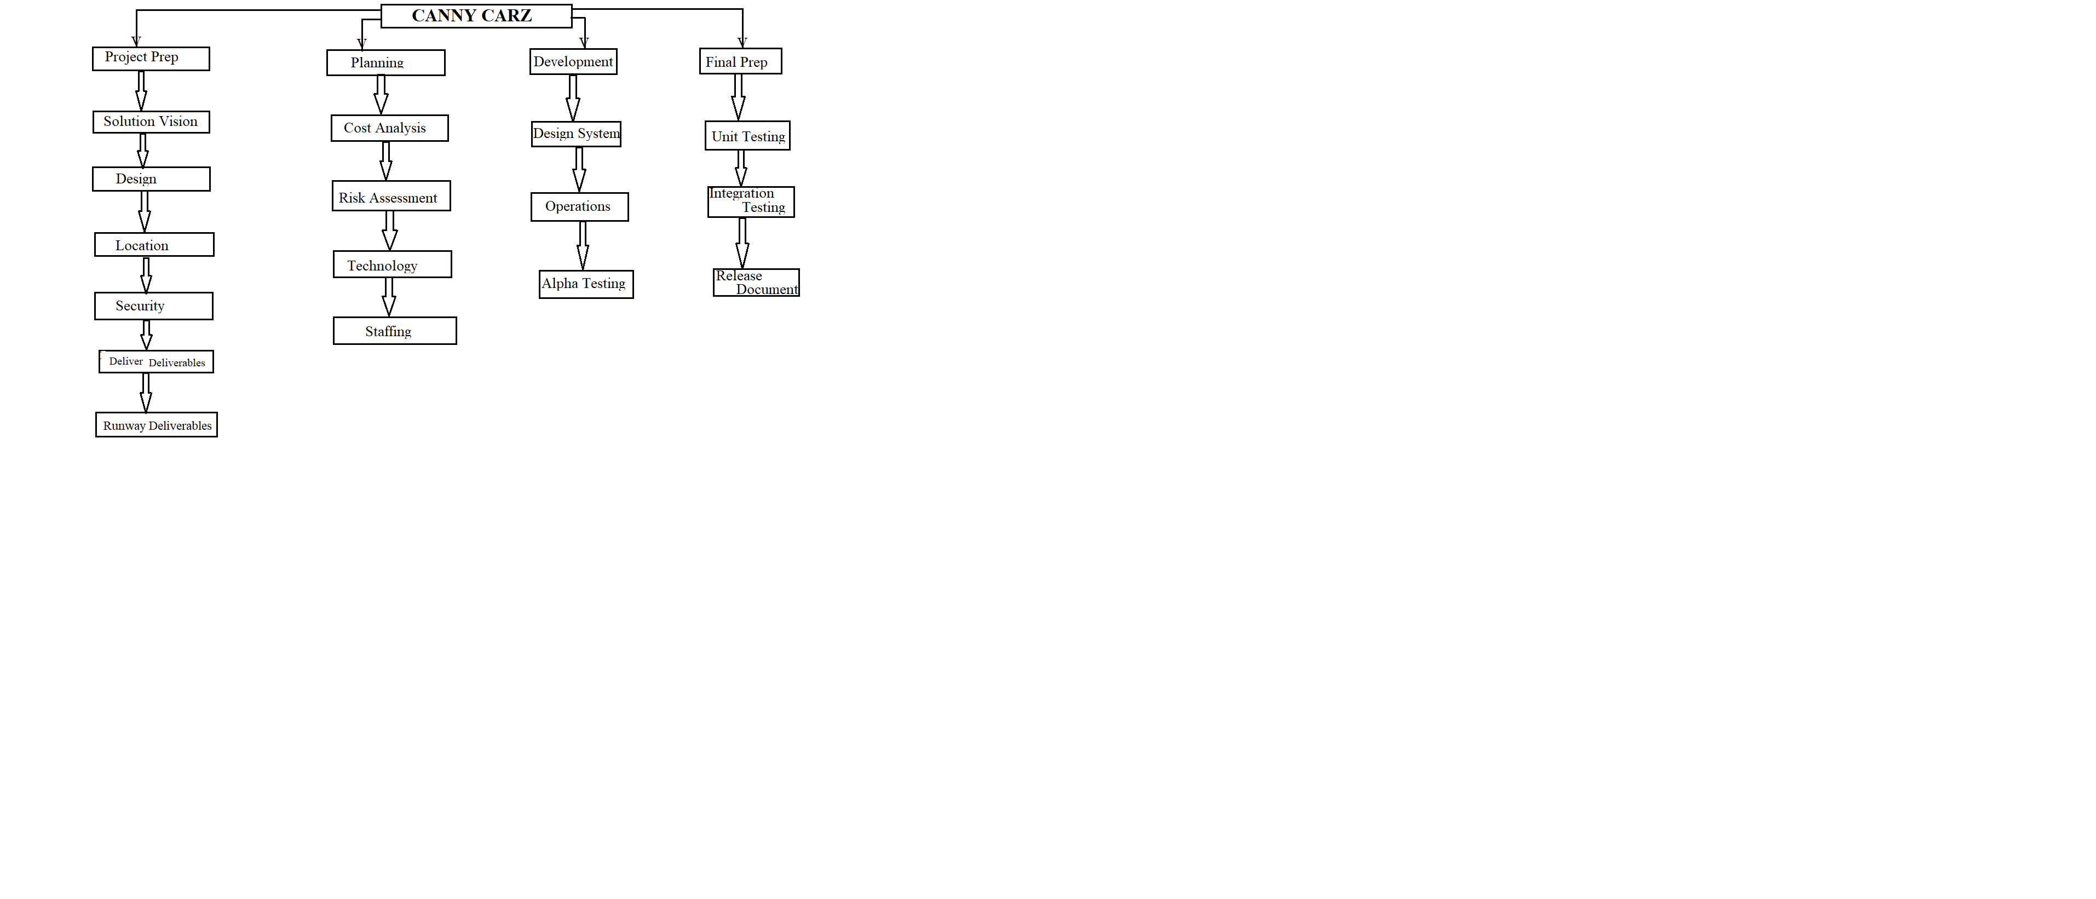
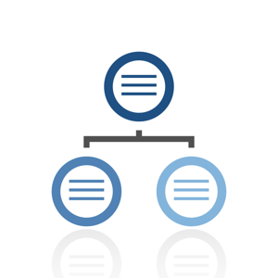
Work-Break Down Structure

Slide 3
Activity List
Activity | Activity with Description | Predecessor | Duration
A | Analyzing Requirements | None | 1 Week
B | Design User Interface | A | 1 Week
C | Develop required pages for User interface | B | 2 Weeks
D | Connecting pages from back end | C | 2 Weeks
E | Data base for storing data | C,D | 2 Weeks
F | Individual page [Unit testing] | C,D,E | 4 Weeks
G | Integration of pages | C,D,E | 2 Weeks
H | Integration testing | G | 1 Week
I | Deployment | H | 1 Week
J | Maintenance for site updation | I | 1 Week

Slide 4
Project Schedule Network Diagram
Start
D
2 Weeks
F
4 Weeks
A
1 week
B
1 Week
C
2 Weeks
H
1 Week
E
2 Weeks
G
2 Weeks
I
1 week
J
1 week
End

Slide 5
Project Schedule Network Diagram
Start
D
2 Weeks
F
4 Weeks
A
1 week
B
1 Week
C
2 Weeks
H
1 Week
E
2 Weeks
G
2 Weeks
I
1 week
J
1 week
End

Slide 6
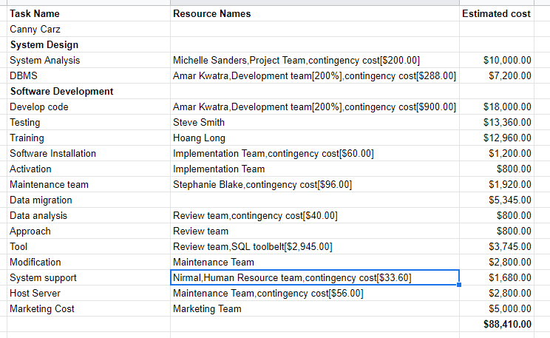
Cost & Expenses

Slide 7
Revenue
Our total sales is $235,000 annually among that $85,000 is our investment and we will have a profit of $150,000.
Among $235,000 $130,000 is on rides and $105,000 on car rentals.
Among $130,000 $75,000 income is on company car rides and $55,000 is on drivers car rides.

Slide 8
Business Model Canvas
If a driver is owning a company’s car on every ride 75% share goes to company and 25% goes to driver.
If a driver takes a ride using company name 25% share goes to company and 75% goes to driver.
If a person is giving his car to the company it can be in the form of contract basis one time payment (Monthly-$700).
Monthly subscription plan $250 will include 35km’s per day ride and overall 35 rides in a month with in a city.
If you are renting a car from company cost depends upon the type of vehicle you rent and insurance should be paid by the customer or else customer can take subscription plan as well.

Slide 9
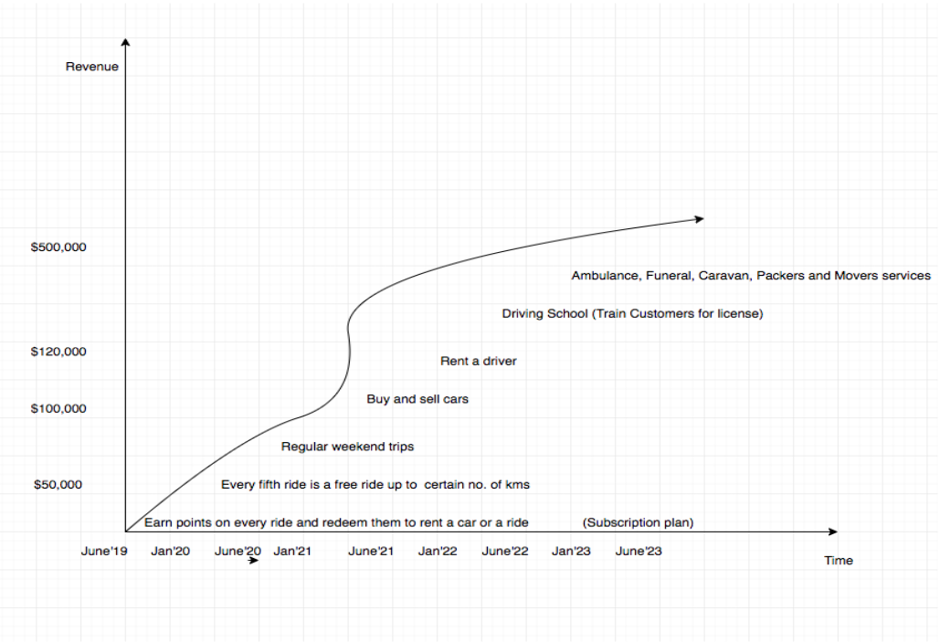
Product Life Cycle

Slide 10
SWOT Analysis
Strengths:
All in one platform.
Global approach.
Easy to navigate.
Easy access to market.
Weakness:
Complex flow of app.
Less social media engagement.
Complex subscription process.
Lack of focus on single service.

Slide 11
Opportunities:
Wide range of customer reach.
Diverse customer base to target (diverse demographics).
Break monopoly of the available platforms.
Integration with government services.
Threats:
Competition with big players(Uber, Lyft, Uhaul)
Customers resistance to new adaption.
Political uncertainties (Taxi lobby or for integration of government services.)
High car insurances in certain areas.

Slide 12
Marketing
Canny Carz inclusion on google maps.
Make app visible on app store with optimization search results.
Advertisement print and electronic media.
Facebook page.
Youtube Page for video instructions to get along canny carz.

Slide 13
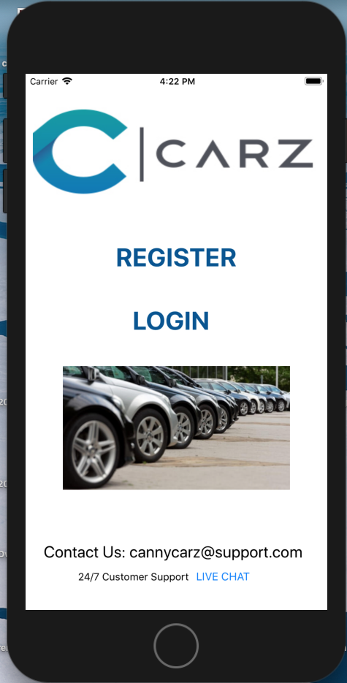
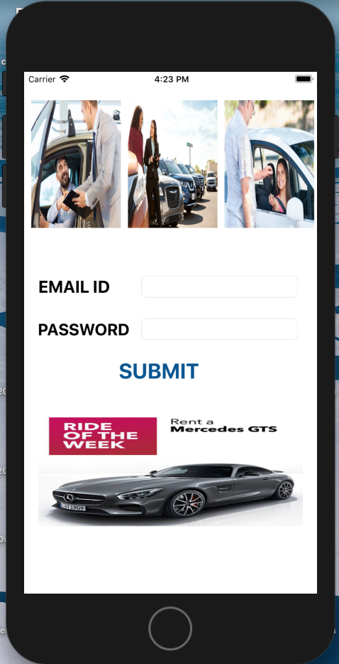
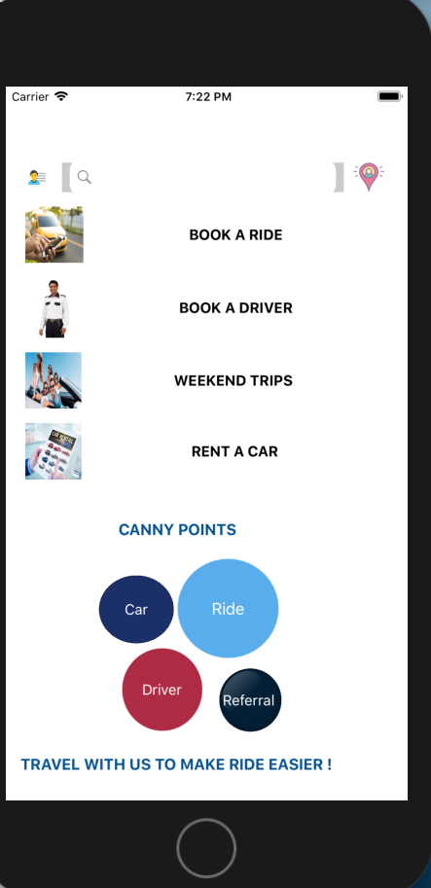
Screenshots

Slide 14
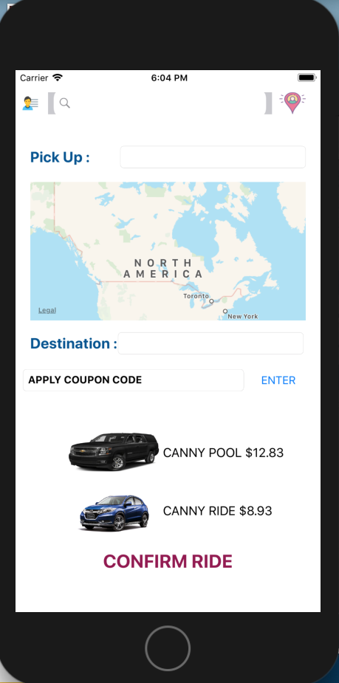
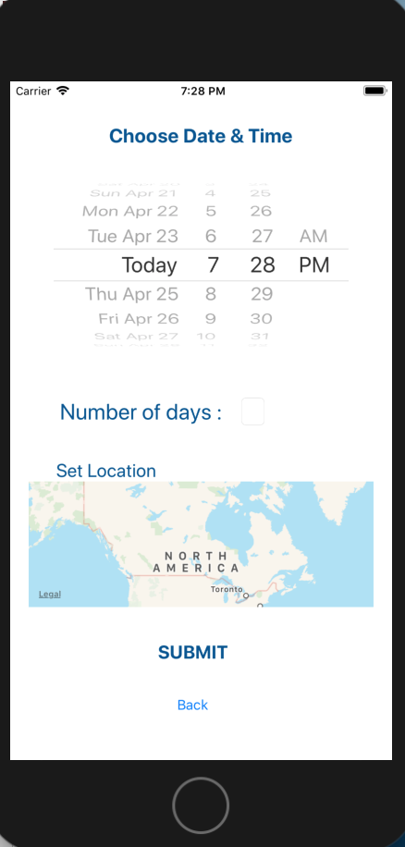
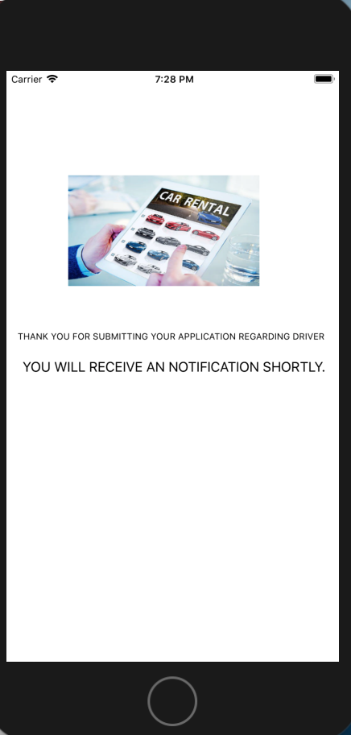

Slide 15
THANK YOU
Any Questions?

